Slide 1
Analyzing air quality in Stuttgart using official and Citizen-Science data
Seminar: GIS Analyses with FOSSGIS Speakers: Amandus Butzer, Julian Käflein Teacher: Christina Ludwig 29.01.2019

Slide 2
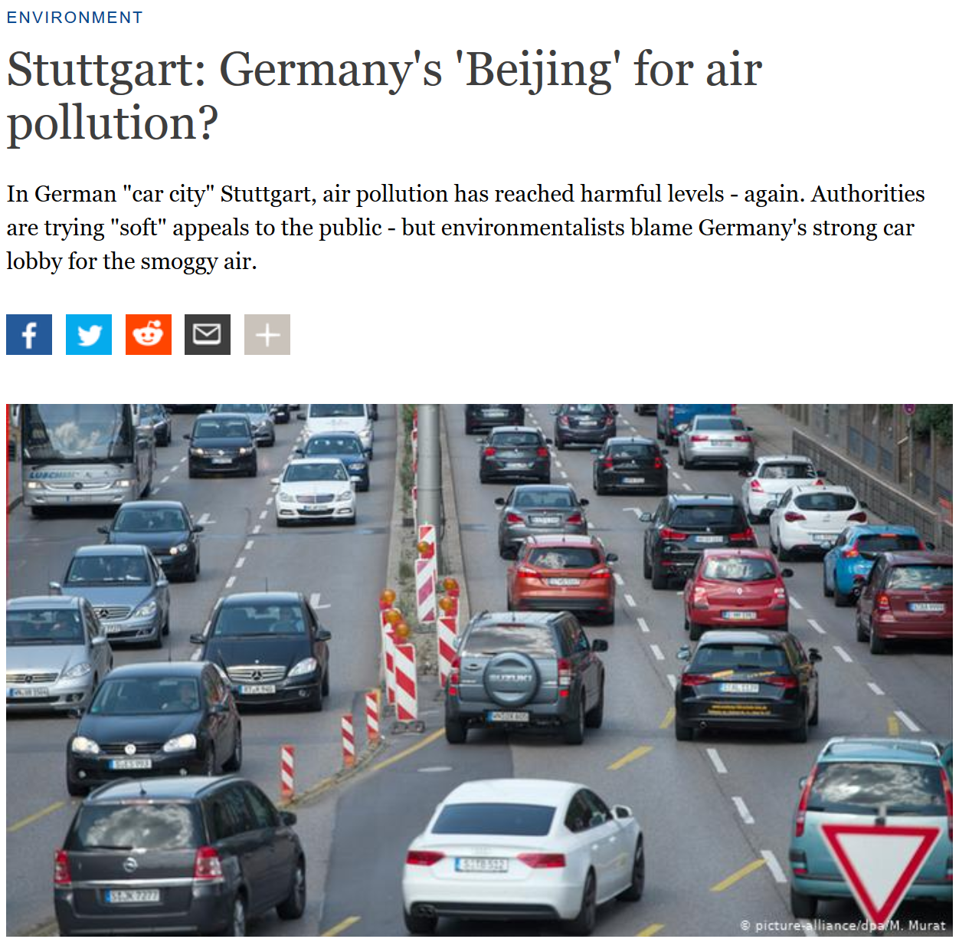
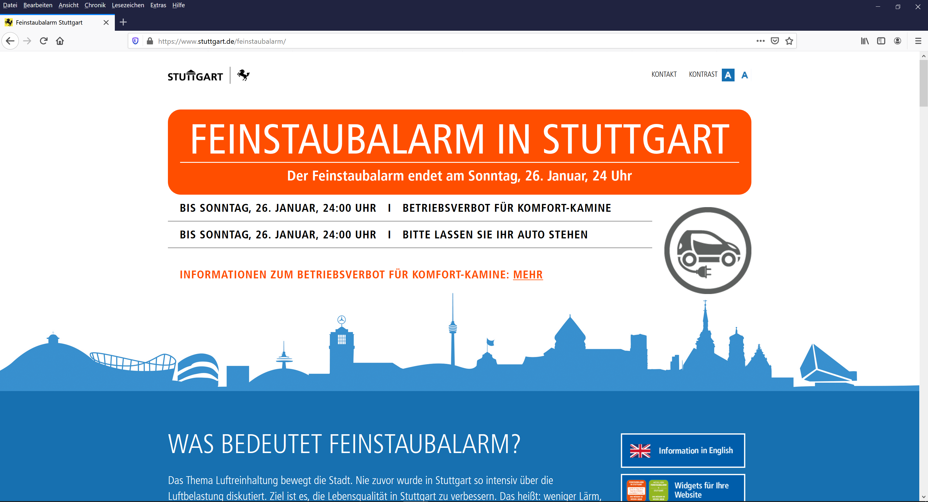
Motivation
Source: https://www.stuttgart.de/feinstaubalarm/
https://www.dw.com/en/stuttgart-germanys-beijing-for-air-pollution/a-18991064

Slide 3

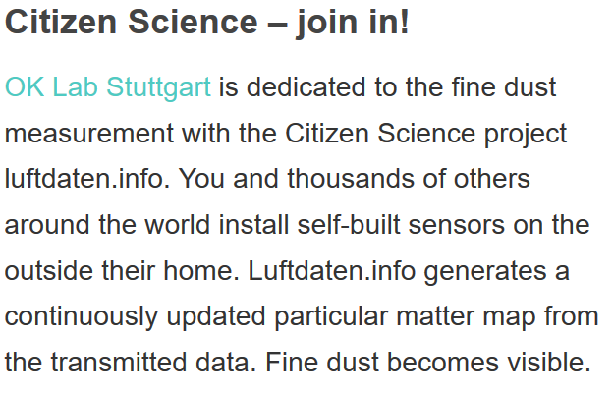
Motivation
Source: https://luftdaten.info/en/home-en/

Slide 4
Motivation
Particulate Matter (PM) Defintion: Solid and liquid airborne particles under 10/2.5µm diameter (PM10/PM25)
Health hazards: Short term irritation/ inflammation of respiratory system, allergic reactions, asthma
Long-term increase of cardiovascular, respiratory diseases
Sources: Industrial processes, Heating, Traffic
Stuttgart:
Problem (1): Concentration of PM exceeding German/ European limits in recent
Reaction: Introduction of „Feinstaubalarm“ – plea to use public transport, ban of ‚comfort heating‘
Problem (2): Amount of PM sensors – 3 sensors by Landesanstalt für Umwelt Baden-Württemberg (LUBW)

Slide 5
Scientific goal
(How) can we analyze the particulate matter concentration
in the city of Stuttgart
based on Volunteered Geographic Information (VGI)
using Free and Open Source Geographic Information Systems (FOSSGIS)
in an automated process?

Slide 6
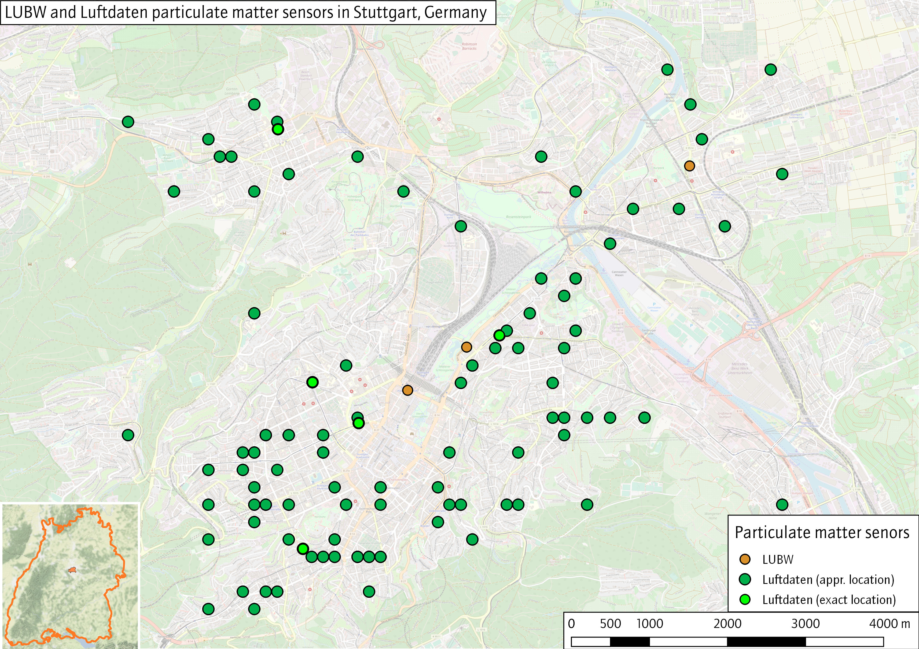
Research area

Slide 7
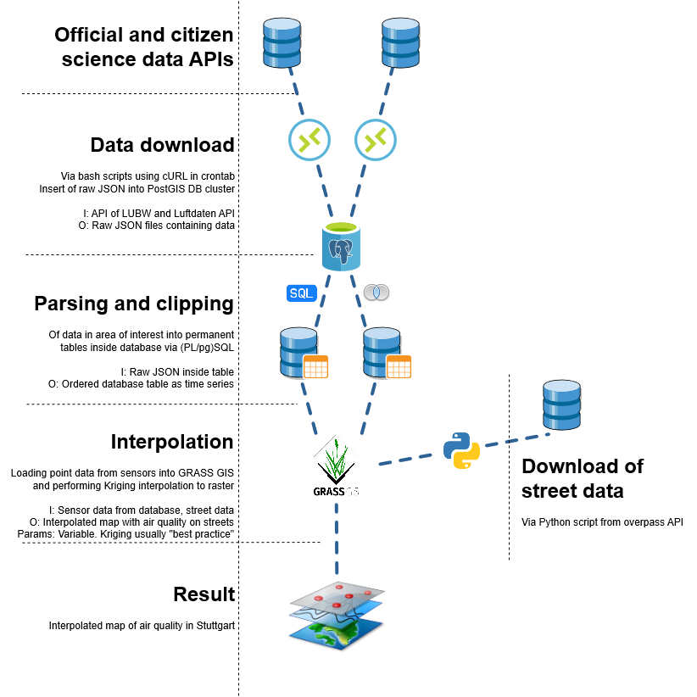
Workflow
e
Luftdaten:
Rate: Hourly values
Sensors: All (global)
Format: JSON
URL: https://data.sensor.community/static/v2/data.1h.json
Size: ~ 9MB (!)

Slide 8
Workflow
LUBW
Rate: Hourly values
Sensor: All (Baden-Württemberg)
Format: GeoJSON
URL: https://lupo-messwerte.appspot.com/ generic?table=bw_luft_stammdaten&limit= 999&filter=aktiv:true;type:- Spot&order=NO2-today-latest-class
Size: 228KB

Slide 9
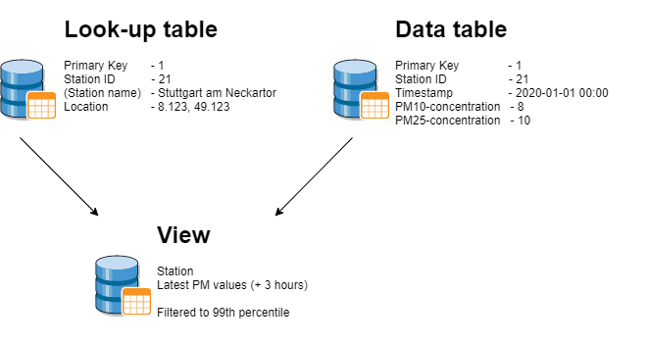
Workflow
e
Workflow
Download data every hour
Insert raw data into staging database
Parse raw data:
3.1. LUBW: Select all Stations within Stuttgart Select relevant air quality values
3.2 Luftdaten:
Build geometry from Lat/Lon
Select only relevant values / sensors
Clip stations within Stuttgart
Insert stations / values into tables
e

Slide 10
Workflow
Workflow

Slide 11
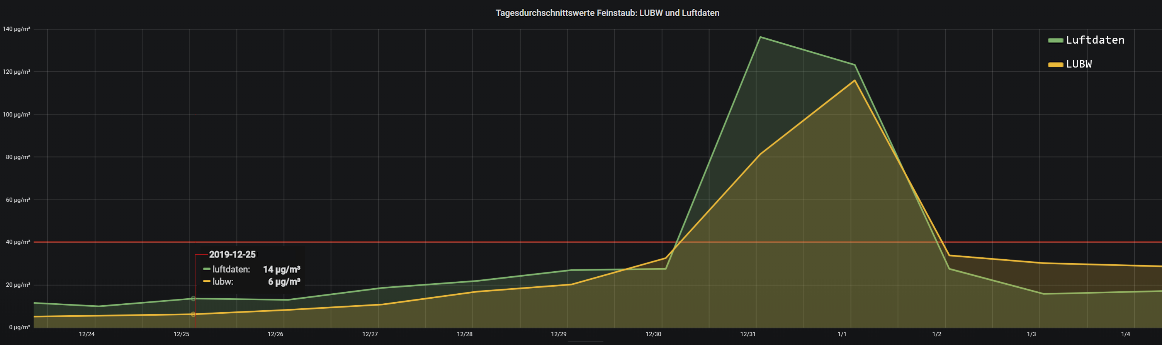
Analysis
Daily average PM10 concentration for LUBW sensors vs Luftdaten sensors within 1000m distance
Method: Buffering, daily average comparison
Software: PostGIS, Grafana
Relevant Parameters:
LUBW PM10 sensor data
All Luftdaten sensors within 1km
Script in GitHub repo

Slide 12
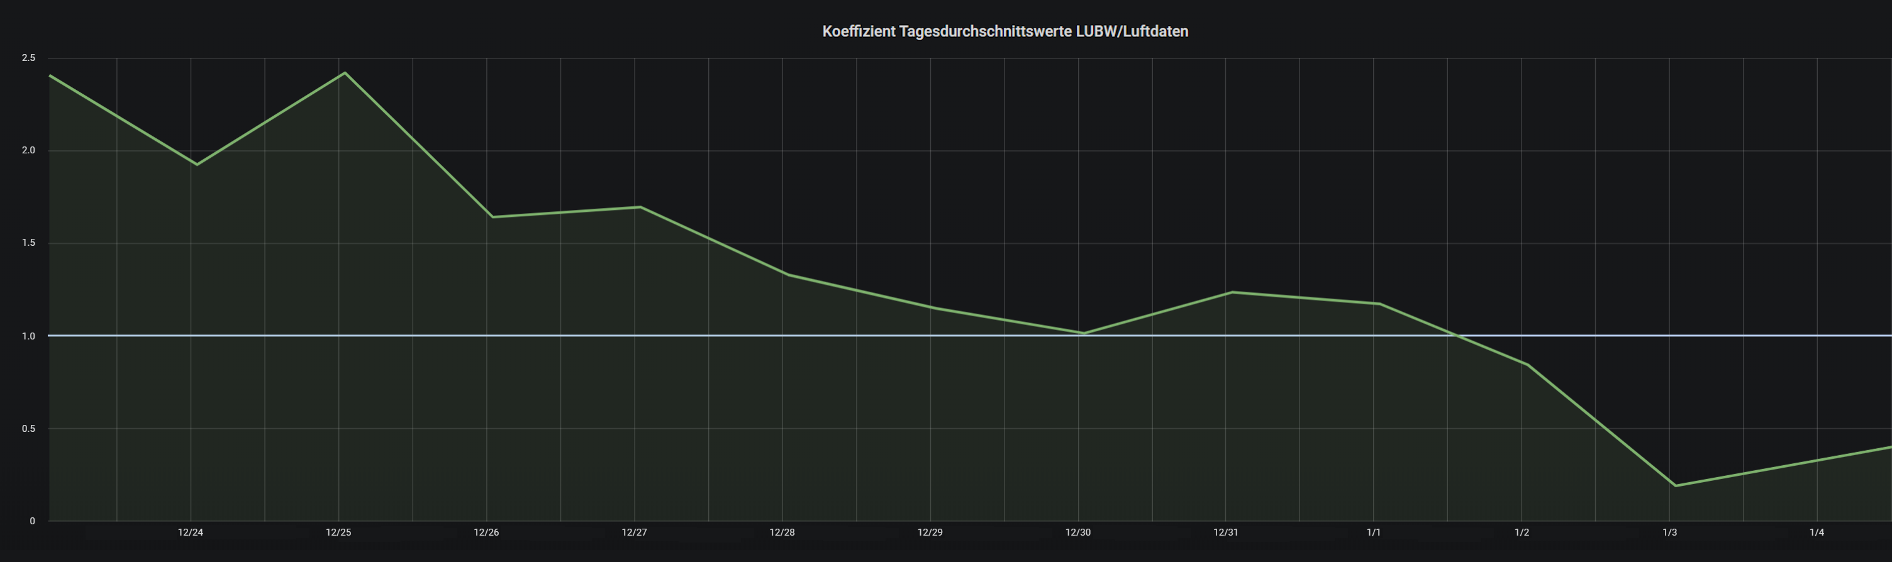
Analysis
Method: Buffering, daily coefficient comparison
Software: PostGIS, Grafana
Relevant Parameters:
LUBW PM10 sensor data
All Luftdaten sensors within 1km
Script in GitHub repo
Daily average PM10 concentration – difference coefficient

Slide 13



Analysis - Interpolation
24µg/m³
12µg/m³

Slide 14
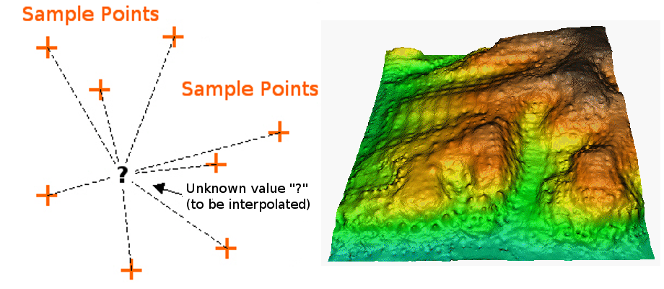
Method – Inverse Distance Weighted
Interpolated Point = linear weighted combination of nearby values
Power: Defines Distance Impact on value.
No interpolation outside value range
Good for data correlated to distance (noise)

Slide 15
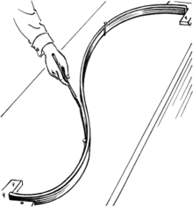
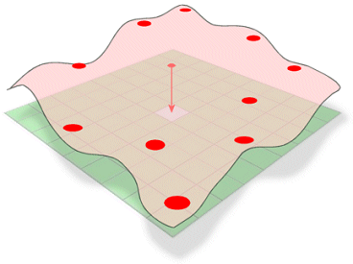
Method – B-Splines
https://upload.wikimedia.org/wikipedia/commons/thumb/f/fd/
Spline_%28PSF%29.png/220px-Spline_%28PSF%29.png
Like IDW the surface passes exactly through datapoints
„Rubber Sheet glued to points“ Minimum curvature Interpolation outside value range
Smoother surface Using Tykhonov regularization
http://www.geography.hunter.cuny.edu/~jochen/GTECH361/
lectures/lecture10/3Dconcepts/Spline_files/image001.gif

Slide 16
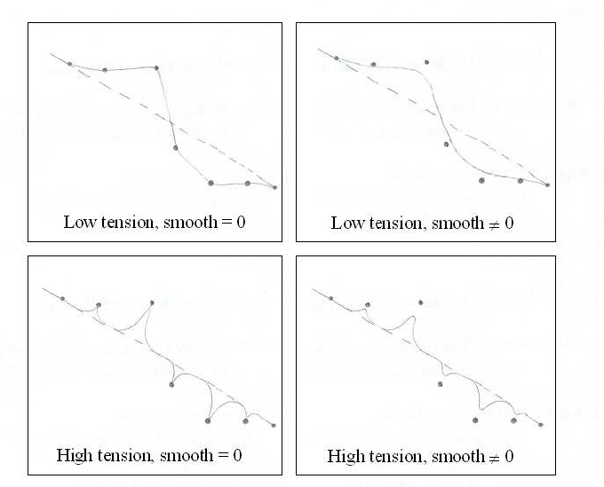
Method – Regularized Splines w. Tension
Tension and Smoothing of Splines possible
Plethora of output possible: - elevation(basic value output) - slope - aspect - curvatures - treeseg -> Best interpolation method so far
https://www.researchgate.net/profile/Domenico_Sguerso/publication/228701243/figure/fig12/AS:302005378666509@1449015101871/Sketch-of-RST-interpolation-results-with-high-low-tension-and-smoothing-equal-or-not-to.png

Slide 17
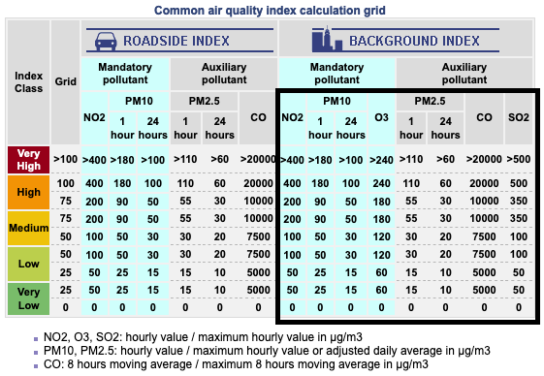
Method – Reclassification
EU-defined Common Air Quality Index (CAQI)
Using Background Index as station position not exact enough. Method: r.reclass
http://www.airqualitynow.eu/about_indices_definition.php

Slide 18
Method – Advanced Raster to GeoJson
r.to.vect
v.generalize
v.out.ogr
categorized raster
category polygons in geojson

Slide 19
Analysis – Milestones so far
Automated download of data
Automated ingestion of data into database
Automated parsing and filtering of extreme values
Connection of GRASS GIS modules to database
Import of stations and data
Automated interpolation of air quality data to raster
Routing WebApp to avoid highly polluted areas

Slide 20
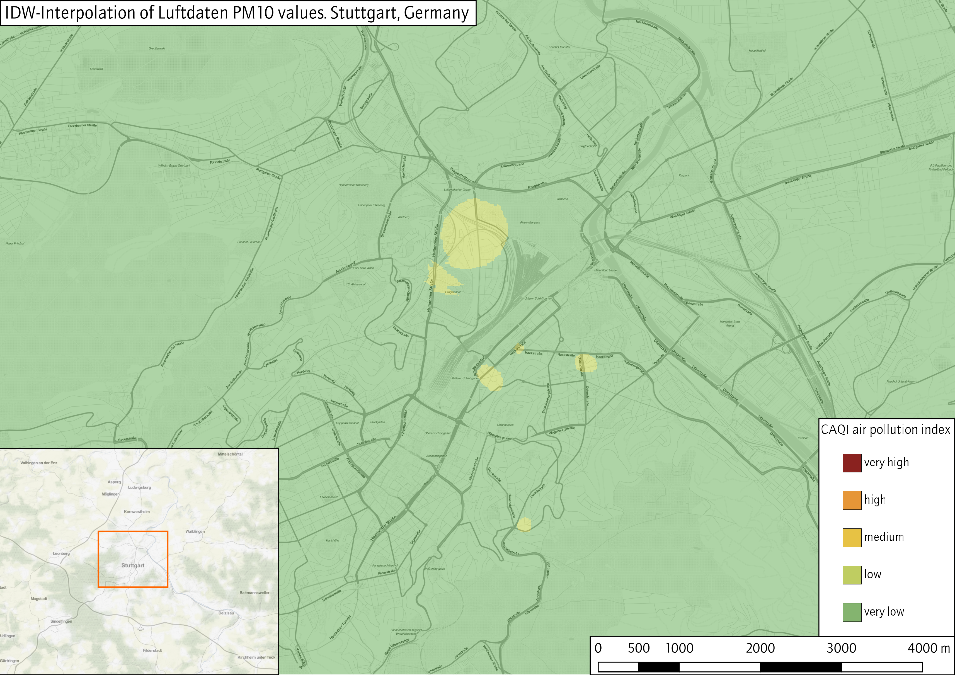
Results
Method: IDW-Interpolation
Software: GRASS-GIS
Module: v.surf.idw
Relevant Parameters:
input: luftdaten_pm10_latest
power (factor): 2.0
npoints=12

Slide 21
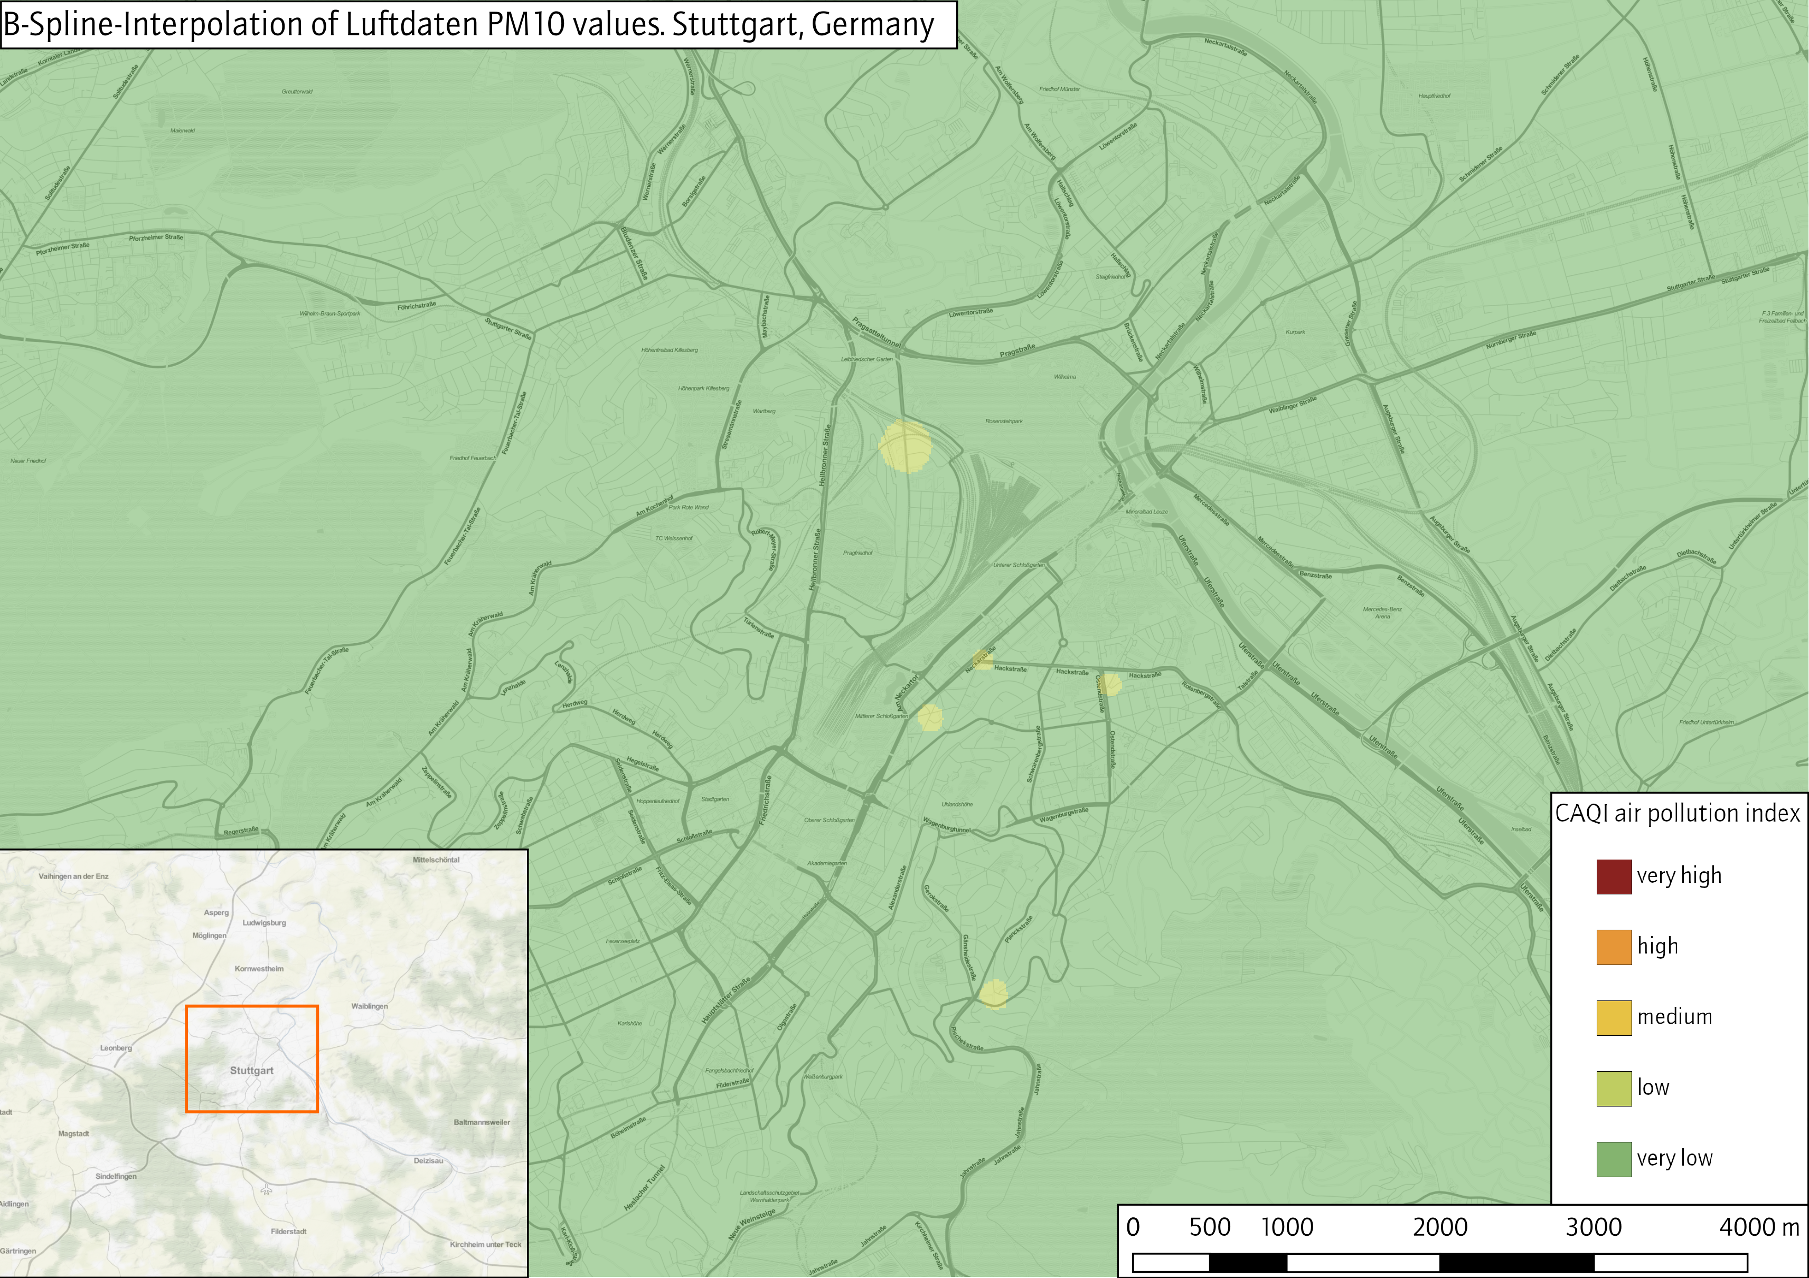
Results
Method: B-Spline-Interpolation
Software: GRASS-GIS
Module: v.surf.bspline
Relevant Parameters:
input: luftdaten_pm10_latest
lambda_i=0.01
ns_step=50
ew_step=50

Slide 22
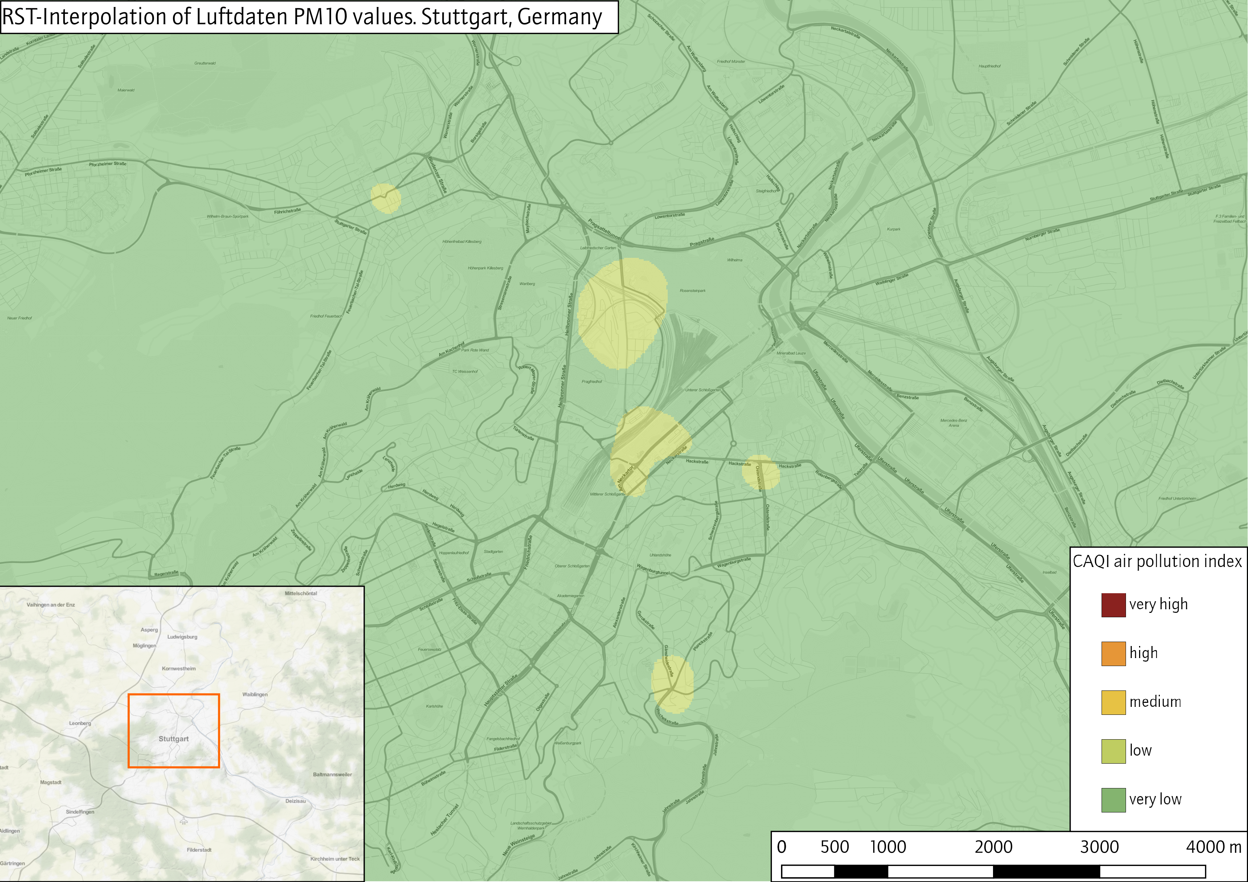
Limitations of the analysis
Method: RST-Interpolation
Software: GRASS-GIS
Module: v.surf.idw
Relevant Parameters:
input: luftdaten_pm10_latest
tension=40
smooth=0.5
segmax=10
npmin=50

Slide 23
Routing Webapp
Vue webapp using
- vue2leaflet
- openrouteservice-js
- category geojson as avoid polygons

Slide 24
Results
Modelling air quality / pollution in Stuttgart
Official sensors
Sparse network of official sensors in research area
Modelling air pollution impossible without additional information
Luftdaten.info sensors
Relatively large, non-systematic discrepancy between Luftdaten and LUBW sensors (cf. LUBW 2017)
BUT
Luftdaten network can sense general particulate matter trend in Stuttgart
SO
Citizen Science / Volunteered Geographic Information enriches model

Slide 25
Limitations of the analysis
Accuracy of Luftdaten sensors
Need to filter extreme values (both absolute and relative)
Constant discrepancy to official measurements
Interpolation parameters are „best fit“
No ‚correct‘ solution to model pollution rasters from sensors
Small scale of study area
Large effects of additional factors, i.e atmospheric conditions (wind / precipitation) /
land cover (buildings / parks)
Short amount of sensing time so far

Slide 26
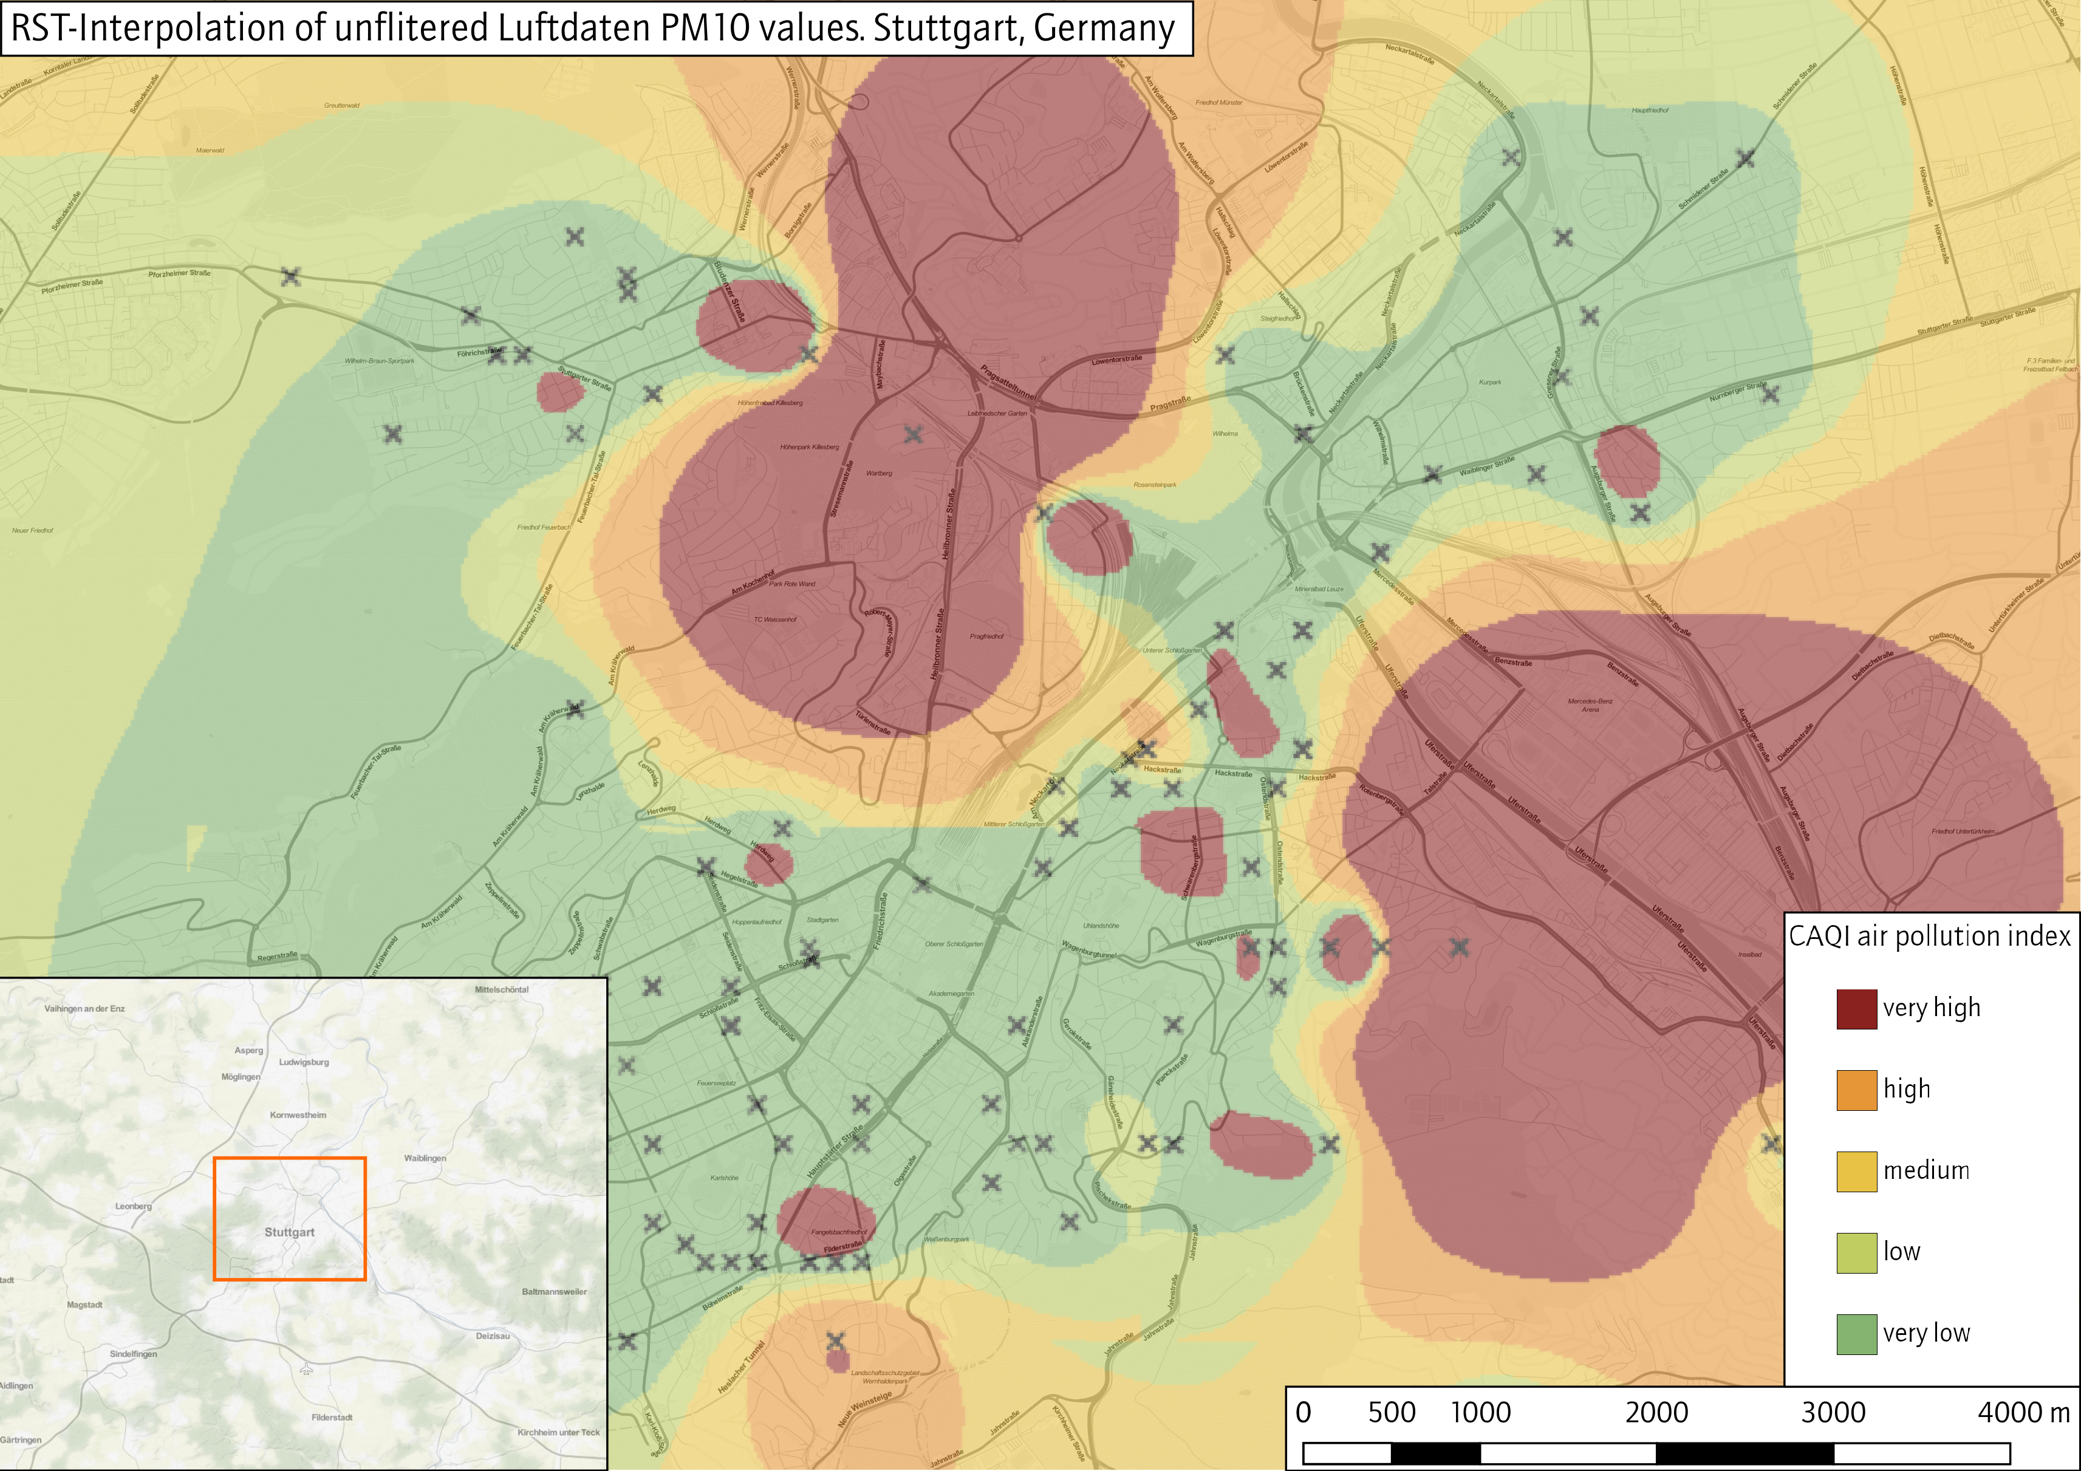
Limitations of the analysis
Method: RST-Interpolation
Software: GRASS-GIS
Module: v.surf.rst
Relevant Parameters:
input: luftdaten_pm10_latest
power (factor): 2.0
npoints=12

Slide 27
Recommended literature
Briggs, D. et al. (1997) Mapping urban air pollution using GIS: a regression-based approach, International Journal of Geographical Information Science, 11 (7), 699-718.
Li, L. Zhou, W. Tong, W. (2019): Spatiotemporal Analysis of Air Pollution and Its Application in Public Health. Amsterdam, Oxford, Cambridge: Elsevier. 328 p.
LUBW (2017): Messungen mit dem Feinstaubsensor SDS01. Ein Vergleich mit einem eignungsgeprüften Feinstaubanalysator. Online source: https://pudi.lubw.de/detailseite/-/publication/90536-Ein_Vergleich_mit_einem_eignungsgepr%C3%BCften_Feinstaubanalysator.pdf
Matějíček et al. (2006): A GIS-based approach to spatio-temporal analysis of environmental pollution in urban areas: A case study of Prague's environment extended by LIDAR data. In: Ecological Modelling. 199 (3), 261-277.

